Slide 1

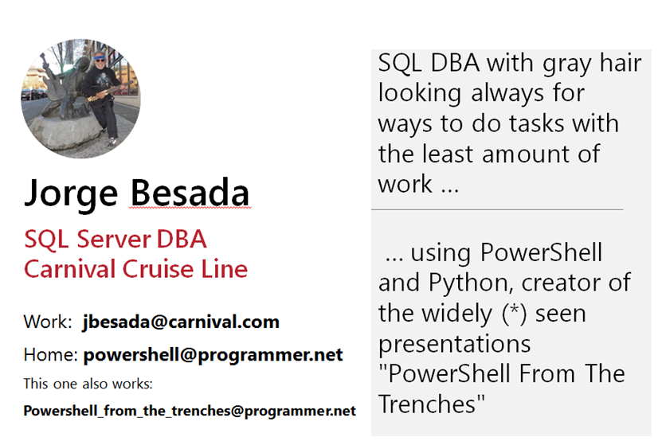

Slide 2
PowerShell From The Trenches - Workflows ...Of Course Yes!
Fast track hands on Powershell Worflows
The PowerShell Workflows ... you have seen them from afar in articles and decided it was too much trouble! I get it, I am describing my personal experience. But you just need to follow some simple steps to start putting them to good use ... augmenting your productivity at work by a big chunk ... which will make the Pointy Haired Boss happy. The Lightning Talk 10 minutes version was presented in PASS (Professional Association of SQL Server) 2019 .
Here with more time we will have a work session with more detail on the examples

Slide 3

Notes:
This is always a good suggestion

Slide 4
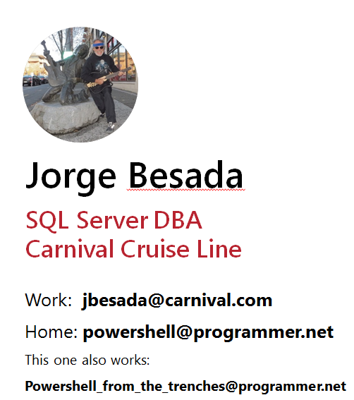
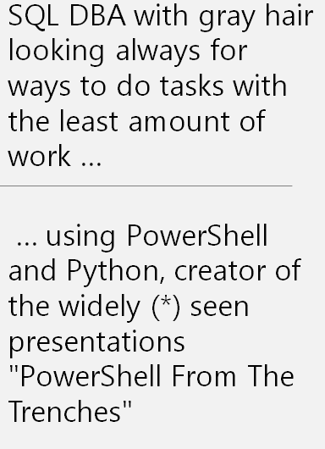

Slide 5
This is the plan
1) WorkFlows – what are they? – the book definition
2) The Hello World workflow program
3) A sample program using jobs
4) A sample program using workflows
5) Jobs program – the workflow version
6) Stopping and restarting worflows
7) Goodie

Slide 6
WorkFlow – what is it – book definition
Windows PowerShell workflows are designed for scenarios
where these attributes are required:
* Long-running activities.
* Repeatable activities.
* Frequently executed activities.
* Running activities in parallel across one or more machines.
* Interruptible activities that can be stopped and re-started, which includes surviving a reboot of the system against which the workflow is executing.
Notes:
this presentation will deal with the last two options: parallel execution and stopping and resuming workflows

Slide 7
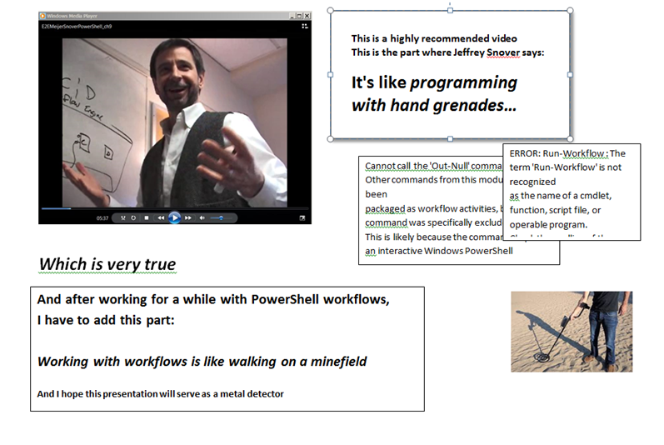
Notes:
And before we start, I highly recommend to everybody to see the video from Jeffrey Snover, the PowerShell creator, and brace yourself for the unexpected ... gazillion errors ... but don’t dispair

Slide 8
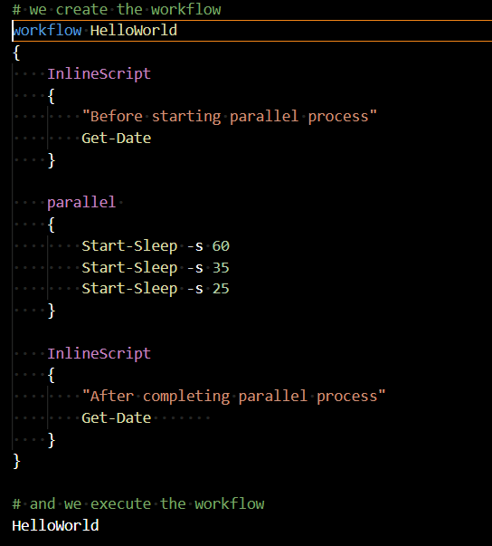
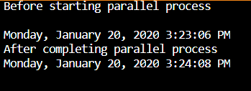
Sample workflow , my HelloWorld version
Take home lessons:
Yes, workflows work as expected:
The total time is the longest of the three “programs”
You define a workflow like a function, and call it
The InlineScripts are your friends
Notes:
If you go to the web tutorials you will see workflow hello world much simpler than this one, but I wanted to include since the very beginning the practical things you will be using all the time

Slide 9
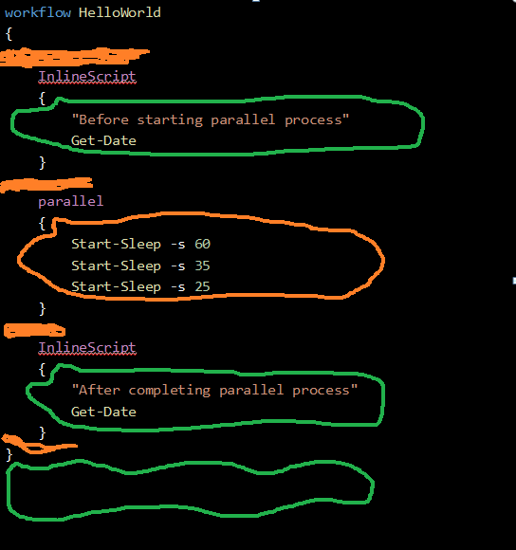
First Things First - Scope and Visibility Green – powershell business as usual area Orange: workflow rules apply
workflow HelloWorld
{
InlineScript
{
"Before starting parallel process"
Get-Date
}
parallel
{
Start-Sleep -s 60
Start-Sleep -s 35
Start-Sleep -s 25
}
InlineScript
{
"After completing parallel process"
Get-Date
}
}
Notes:
Just remember this for later, this is a source of a lot of aggravation and people quitting the workflows adventure ... don’t be a quitter ...

Slide 10
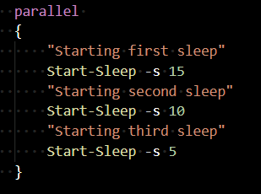


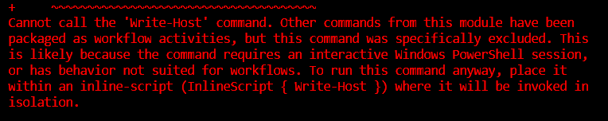

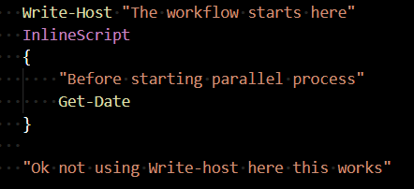
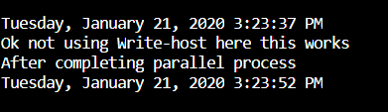
Get used to weird things
This is nice
This is naughty
So these are the suggestions:
In case of errors: use InlineScript when possible
In case of doubt: use InlineScript
When inside Workflow: the error messages are quite detailed ☺, learn from them
Notes:
I have never experienced so many errors and weird things before dealing with workflows. The main issue is that the more familiar you are with the PowerShell syntax ... the worse it is (at least in the beginning)

Slide 11
Good to know you can return stuff from the InlineScript
Good to know
you can pass stuff to the InlineScript
FROM THE BOOK
InlineScript Variables
By default, the variables that are defined in a workflow aren't visible to the commands in the InlineScript script block. To make workflow variables visible to the InlineScript, use the $Using scope modifier. The $Using scope modifier is required only once for each variable in the InlineScript.
Returning variables in InlineScript
InlineScript commands can change the value of the variable that was imported from workflow scope, but the changes aren't visible in workflow scope. To make them visible, return the changed value to the workflow scope
Notes:
Let’s see in the next slides this passing and receiving items to and from inlinescripts in action
Being able to send and receive from the inlinescripts is crucial for the worflower

Slide 12
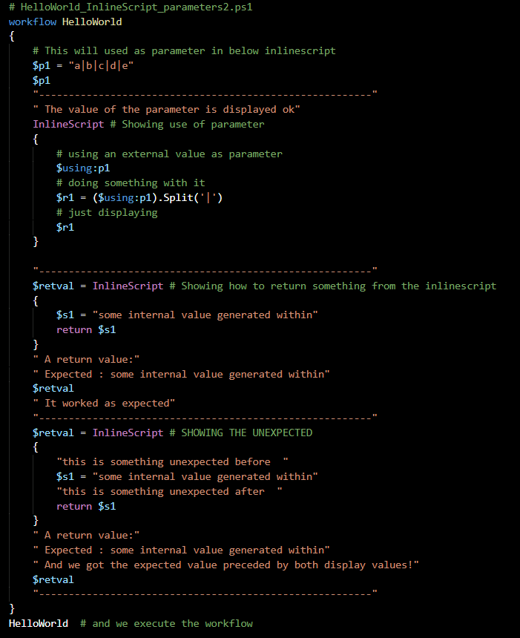
InlineScript : pass and receive values
Notes:
We can pass values to InlineScripts, just remember the $using and beware the trap lurking in the return values ...

Slide 13
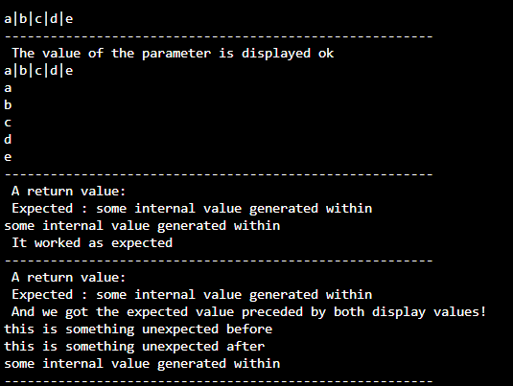
And here we see the output
Notes:
The moral of the story is: don’t display too many things inside InlineScripts, you may get strange results, and when returning values, just don’t display anything

Slide 14
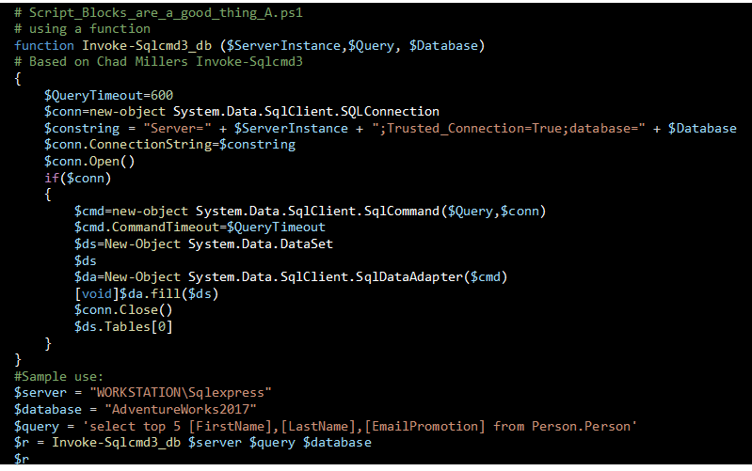
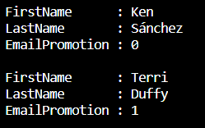
Functions in powershell work fine …
Notes:
Yes they work fine but get in the habit of using script blocks for everything for workflows

Slide 15
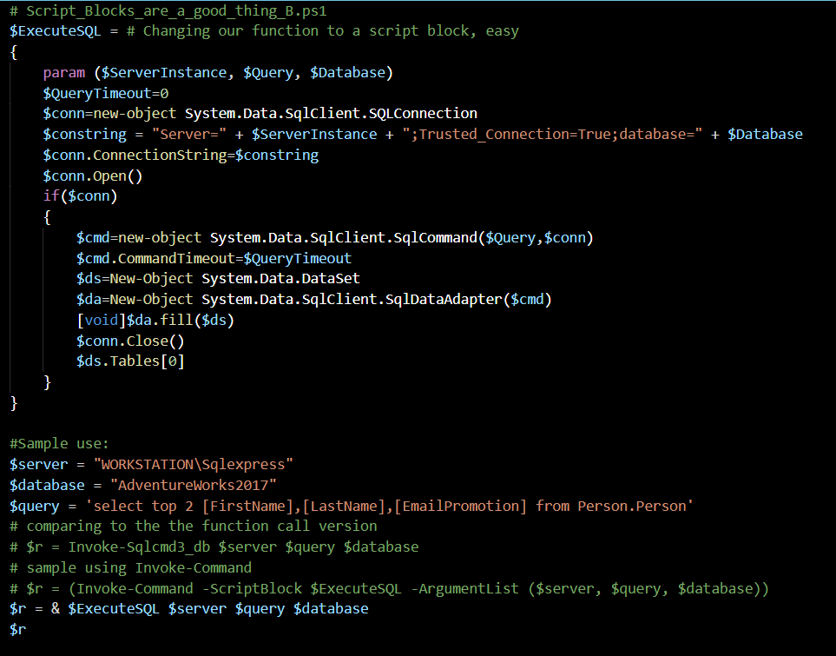
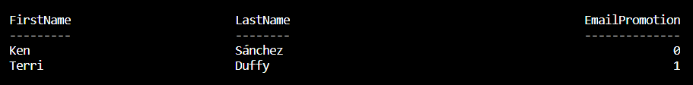
Script Blocks are better friends in workflows
Notes:
Good practice for the workflower: use script blocks and save yourself aggravations in the future
A function is just a scriptblock that has a name associated with it.
Scriptblocks are the neatest thing about PowerShell

Slide 16
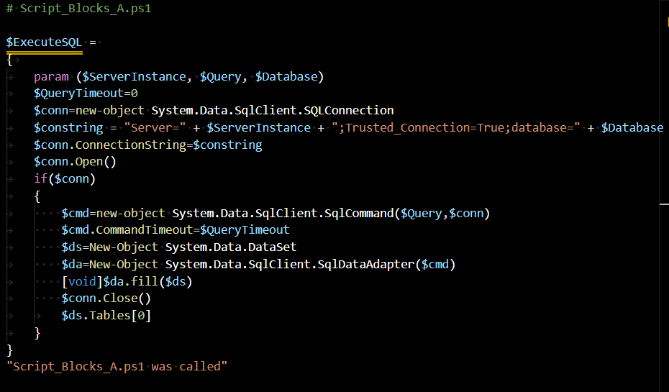

Notes on scope and organizing the code
Notes:
Sample module containing a single script block – no execution, just checking that it was called

Slide 17
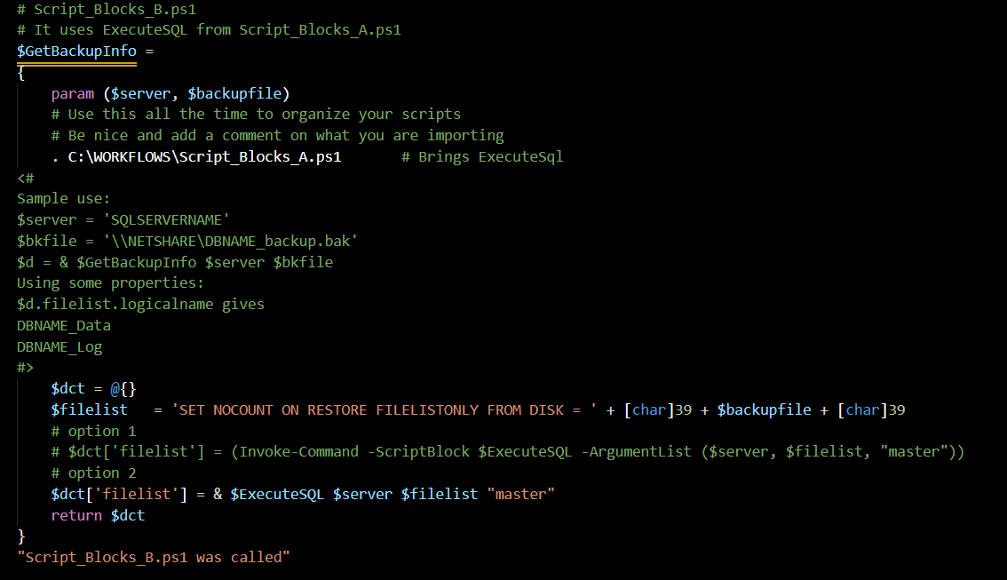

We can import code using the dot and the file name
Nothing is being done yet.
Notes:
Same as before, just creating the script block, not executing it

Slide 18
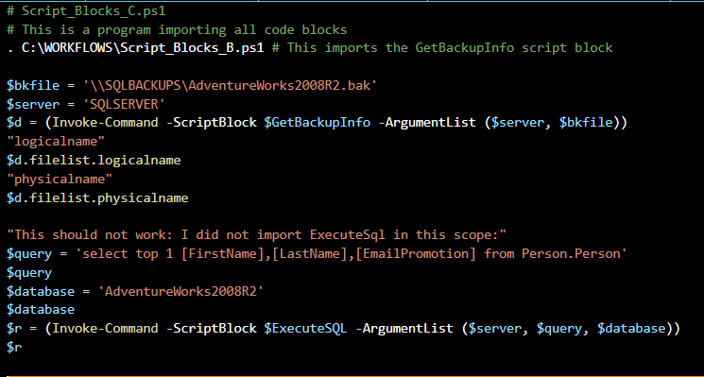
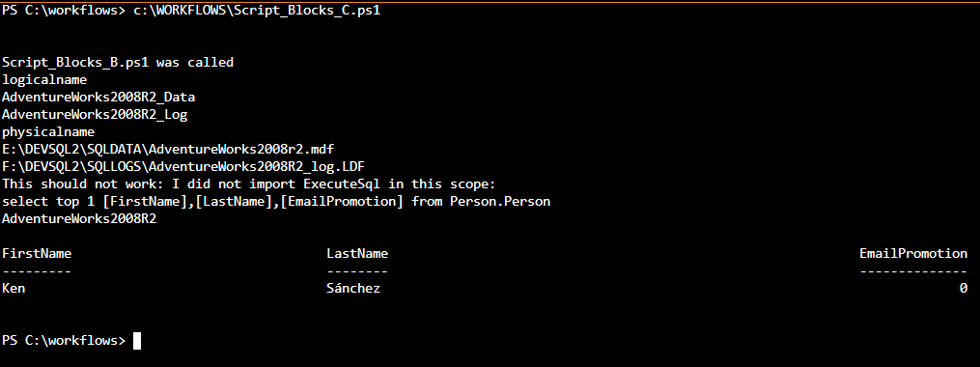
Showing calls for the script blocks from a main program
I was in a hurry and executed from the editor ... and got unexpected results
Notes:
Here we are using the script block import in a main program ... and making the mistake of running from within the editor ... the query sould not have executed !

Slide 19
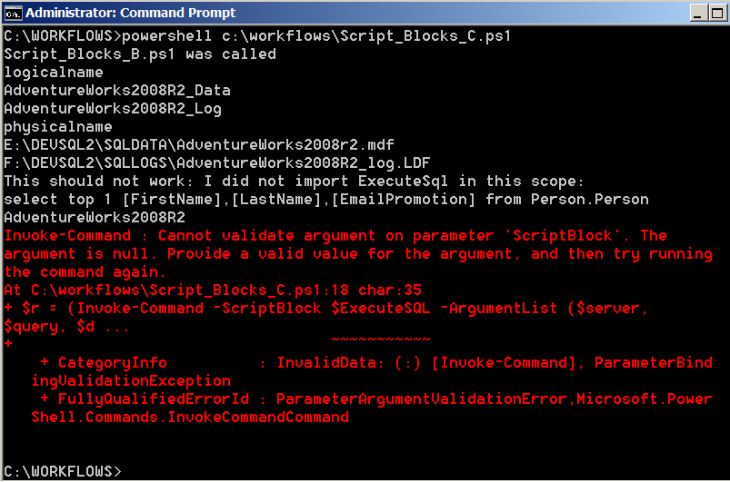
Checking the import process and the usual suspects - fixed
So let’s do the right thing: call the program the right way
from a cmd file like Script_Blocks_C.cmd containing this line
powershell c:\workflows\Script_Blocks_C.ps1
And now it works as expected
Notes:
Note to ourselves: running the code in the Visual Studio Code editor caches the ExecuteSQL code and the code does not err. ALWAYS TEST USING a cmd window and batch file and powershell script, don’t be lazy ... Doing the test the right way confirmed the expectation of the error, all is well. And the wrong way is to test from your editor, you may find that code is cached and what should not work … worked

Slide 20
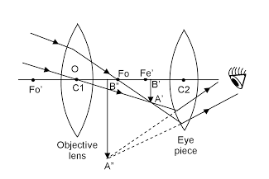


Intermezzo
Visibility is important in the code morass
May the Eye of Ra help you see better
Use script blocks all the time in your support programs
Use InlineScript most of the time in your workflow programs
Always test your program using a cmd file calling your PowerShell script (avoid surprises from your nice favorite editor)
Don’t reinvent the wheel: follow the PowerShell mantra
Steal from the Best
And Create the Rest
And you will be enlightened
Notes:
Ok we have covered the basics, we need a little break, some reminders here of good practices

Slide 21
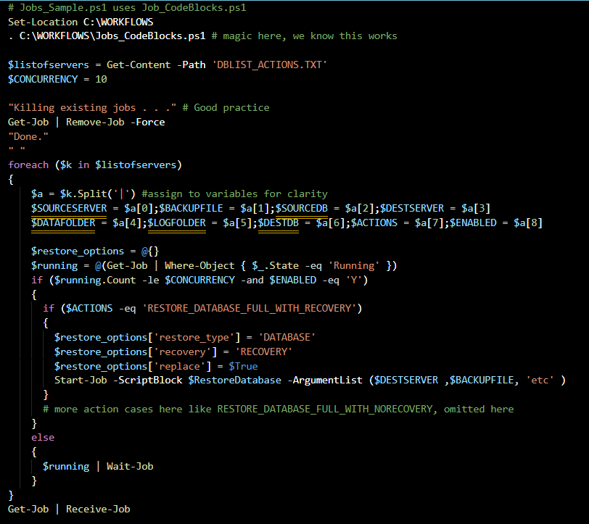


Sample program using jobs
DBLIST_ACTIONS.txt source has a line for each entry with this format
SOURCESERVER|BACKUPFILE|SOURCEDB|DESTSERVER|DATAFOLDER|LOGFOLDER|DESTDB|ACTIONS|ENABLED
Jobs in one slide
Notes:
This is a classic jobs program, using script blocks to manage the code, displaying only one case :restore database full with recovery. The full program has more cases (no recovery, logs). It works well

Slide 22
Output of jobs program
Killing existing jobs . . .
Done.
Id Name PSJobTypeName State HasMoreData Location
-- ---- ------------- ----- ----------- --------
1 Job1 BackgroundJob Running True localhost
1 Job1 BackgroundJob Completed True localhost
3 Job3 BackgroundJob Running True localhost
5 Job5 BackgroundJob Running True localhost
7 Job7 BackgroundJob Running True localhost
3 Job3 BackgroundJob Completed True localhost
5 Job5 BackgroundJob Completed True localhost
7 Job7 BackgroundJob Completed True localhost
Restoring from file
\\SQLBACKUPS\SQLBackupUser\ZZZ_Deleteme_1_backup2.bak
USE MASTER RESTORE DATABASE [ZZZ_Deleteme_1] FROM DISK ='\\SQLBACKUPS\SQLBackupUser\ZZZ_Deleteme_1_backup2.bak' WITH MOVE 'ZZZ_Deleteme_1' TO 'E:\DEVSQL2\SQLDATA\ZZZ_Deleteme_1_Data.mdf', MOVE 'ZZZ_Deleteme_1_log' TO 'F:\DEVSQL2\SQLLOGS\ZZZ_Deleteme_1_Log.ldf', NOUNLOAD, RECOVERY, STATS = 10, REPLACE;
ALTER AUTHORIZATION ON DATABASE::[ZZZ_Deleteme_1] TO [sa]
Latest backup from folder
\\SQLBACKUPS\SQLBackupUser\ZZZ_Deleteme_1_backup2.bak
USE MASTER RESTORE DATABASE [ZZZ_Deleteme_2] FROM DISK ='\\SQLBACKUPS\SQLBackupUser\ZZZ_Deleteme_1_backup2.bak' WITH MOVE 'ZZZ_Deleteme_1' TO 'E:\DEVSQL2\SQLDATA\ZZZ_Deleteme_2_Data.mdf', MOVE 'ZZZ_Deleteme_1_log' TO 'F:\DEVSQL2\SQLLOGS\ZZZ_Deleteme_2_Log.ldf', NOUNLOAD, RECOVERY, STATS = 10, REPLACE;
ALTER AUTHORIZATION ON DATABASE::[ZZZ_Deleteme_2] TO [sa]
Latest backup from folder
\\SQLBACKUPS\SQLBackupUser\ZZZ_Deleteme_1_backup2.bak
USE MASTER RESTORE DATABASE [ZZZ_Deleteme_3] FROM DISK ='\\SQLBACKUPS\SQLBackupUser\ZZZ_Deleteme_1_backup2.bak' WITH MOVE 'ZZZ_Deleteme_1' TO 'E:\DEVSQL2\SQLDATA\ZZZ_Deleteme_3_Data.mdf', MOVE 'ZZZ_Deleteme_1_log' TO 'F:\DEVSQL2\SQLLOGS\ZZZ_Deleteme_3_Log.ldf', NOUNLOAD, RECOVERY, STATS = 10, REPLACE;
ALTER AUTHORIZATION ON DATABASE::[ZZZ_Deleteme_3] TO [sa]
Latest backup from folder
\\SQLBACKUPS\SQLBackupUser\ZZZ_Deleteme_1_backup2.bak
USE MASTER RESTORE DATABASE [ZZZ_Deleteme_4] FROM DISK ='\\SQLBACKUPS\SQLBackupUser\ZZZ_Deleteme_1_backup2.bak' WITH MOVE 'ZZZ_Deleteme_1' TO 'E:\DEVSQL2\SQLDATA\ZZZ_Deleteme_4_Data.mdf', MOVE 'ZZZ_Deleteme_1_log' TO 'F:\DEVSQL2\SQLLOGS\ZZZ_Deleteme_4_Log.ldf', NOUNLOAD, NORECOVERY, STATS = 10, REPLACE;
DECLARE @kill varchar(8000) = ''; SELECT @kill = @kill + 'kill ' + CONVERT(varchar(5), spid) + ';' FROM master..sysprocesses WHERE dbid = db_id('ZZZ_Deleteme_4') EXEC(@kill);
Notes:
Several copies of a ZZZ_Deleteme database were restored with different names, one of them left not recovered , which in later runs was used to apply transaction logs (not shown here)

Slide 23

And now we are ready to do some real workflows work
Notes:
Behold the mother of all workflows ...

Slide 24
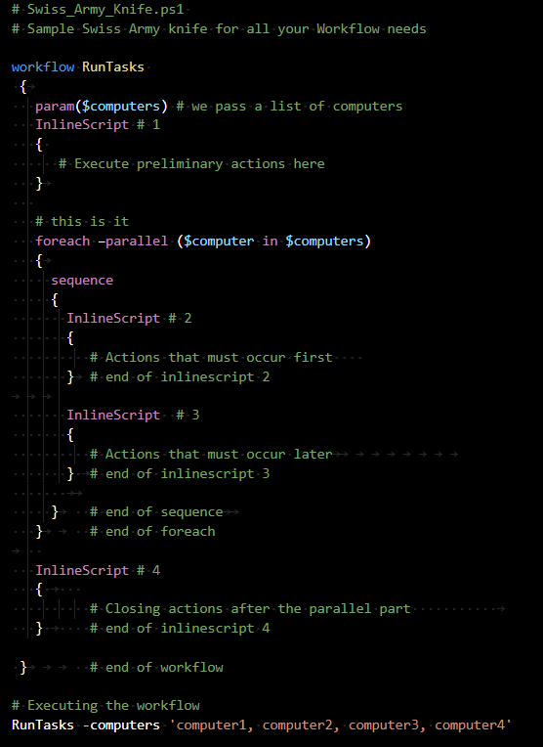
The Swiss Army Knife of the Workflows
It does everything (*)
You can:
pass parameters
insert actions before
use the magic of the
foreach -parallel
insert actions after
(*) ok, almost everything
Notes:
Save this model and use it everywhere, don’t leave home without it. In most cases you will not need the sequence part, but sometimes it comes handy to deal with the order of actions in parallel process, will see in the next slide

Slide 25
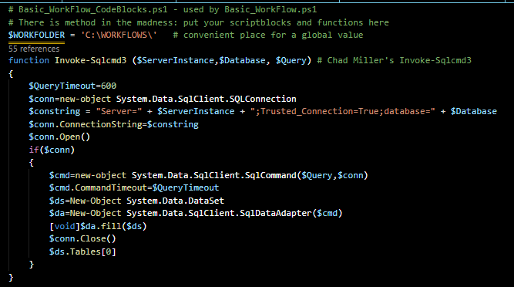
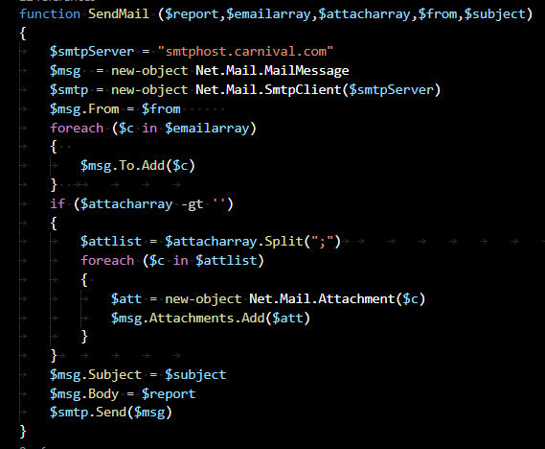
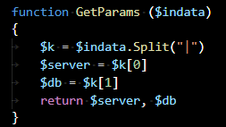
Preparing conditions for our first workflow Here is the Basic_Workflow_CodeBlocks.ps1where we store all the support functions
Notes:
Will create a program that will get data from several servers and databases, saves data in files, compresses them and emails a report. And we will do it in an organized fashion, with support modules and the works

Slide 26
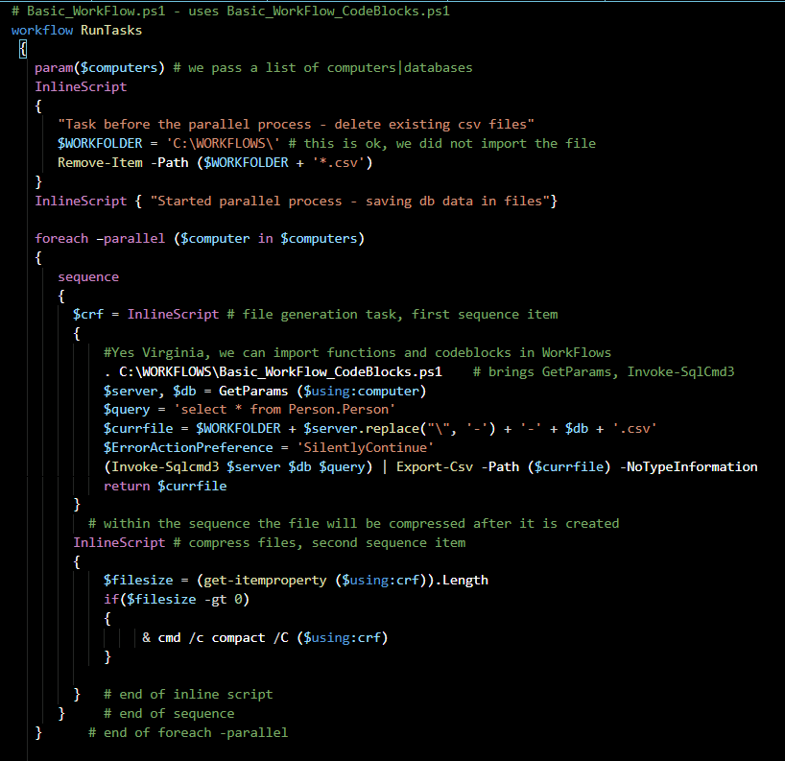
Our first workflow program , first screen
Notes:
Showing this in two screens, for ease of viewing: workflow is defined, a list of values passed to it, and for each list value actions are applied: getting files from database and compressing them

Slide 27
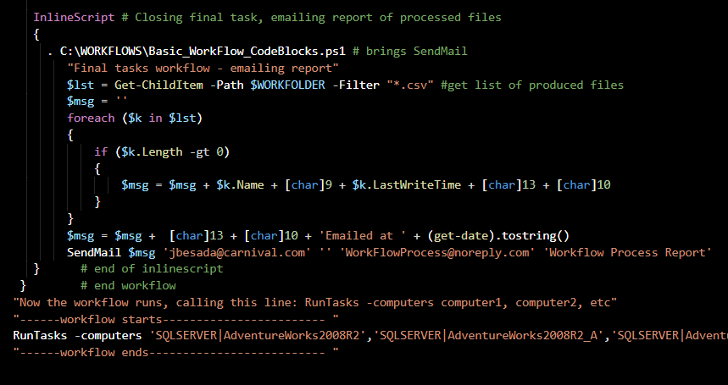
Our first workflow program , second screen
We change into C:\WORKFLOWS, where we have our cmd file Basic_Work.cmd
, which looks like this
powershell C:WORKFLOWS\Basic_Workflow.ps1 > C:\WORKFLOWS\Basic_Workflow.out
and we execute it ...
Notes:
And after the parallel section of the program an email report is created, and the workflow executed

Slide 28
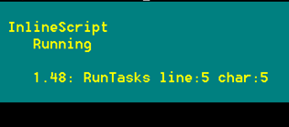
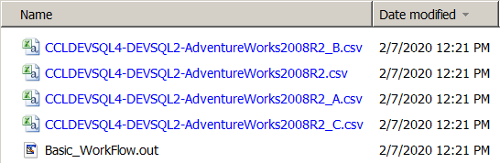
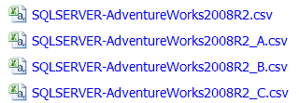
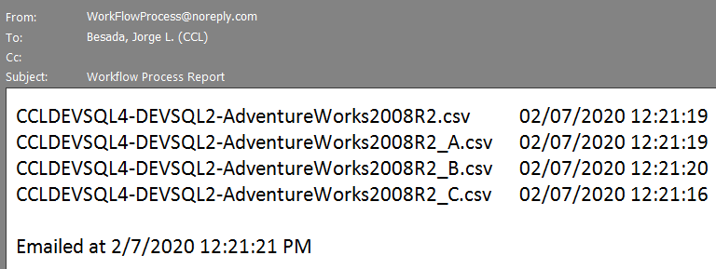
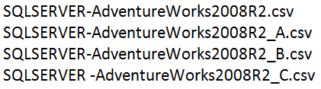
And here we see the output produced, chatty output helps the newbie
Now the workflow runs, calling this line: RunTasks -computers computer1, computer2, etc
------workflow starts------------------------
Task before the parallel process - delete existing csv files
Started parallel process - saving db data in files
computer:SQLSERVER|AdventureWorks2008R2_C
computer:SQLSERVER|AdventureWorks2008R2_B
computer:SQLSERVER|AdventureWorks2008R2_A
computer:SQLSERVER|AdventureWorks2008R2
Compressing files in C:\WORKFLOWS\
SQLSERVER-AdventureWorks2008R2_C.csv 13884824 : 5206016 = 2.7 to 1 [OK]
1 files within 1 directories were compressed.
13,884,824 total bytes of data are stored in 5,206,016 bytes.
The compression ratio is 2.7 to 1.
Compressing files in C:\WORKFLOWS\
Compressing files in C:\WORKFLOWS\
SQLSERVER-AdventureWorks2008R2_B.csv 13884824 : 5206016 = 2.7 to 1 [OK]
1 files within 1 directories were compressed.
13,884,824 total bytes of data are stored in 5,206,016 bytes.
The compression ratio is 2.7 to 1.
SQLSERVER-AdventureWorks2008R2_A.csv 13884824 : 5206016 = 2.7 to 1 [OK]
1 files within 1 directories were compressed.
13,884,824 total bytes of data are stored in 5,206,016 bytes.
The compression ratio is 2.7 to 1.
Compressing files in C:\WORKFLOWS\
SQLSERVER-AdventureWorks2008R2.csv 13884824 : 5206016 = 2.7 to 1 [OK]
1 files within 1 directories were compressed.
13,884,824 total bytes of data are stored in 5,206,016 bytes.
The compression ratio is 2.7 to 1.
Final tasks workflow - emailing report
------workflow ends--------------------------
Notes:
No surprises, worked as expected

Slide 29
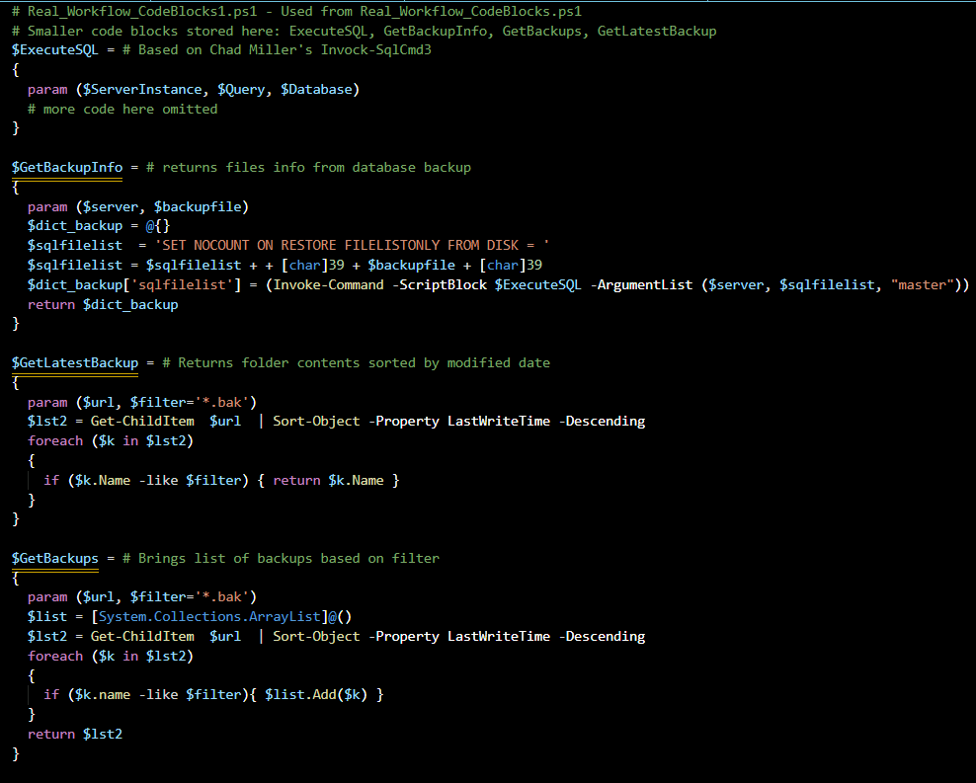
Now we are ready, let’s “worflowize” the jobs program Let’s see the support script blocks first - Real_Workflow_CodeBlocks1.ps1
Notes:
All the smaller script blocks that do not depend on other blocks saved in this file

Slide 30
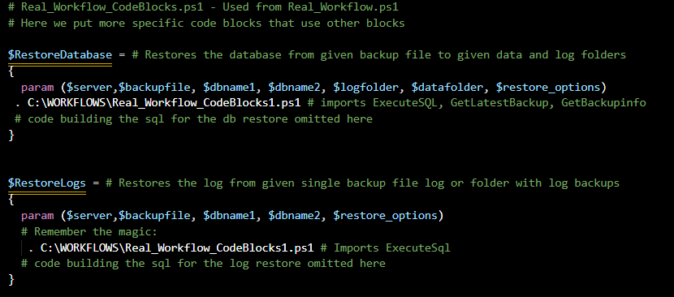
“worflowization” of the jobs program continues Let’s see the other support script blocks - Real_Workflow_CodeBlocks.ps1
Notes:
This one contains the big script blocks, each one of them use the common support blocks in the previous file

Slide 31
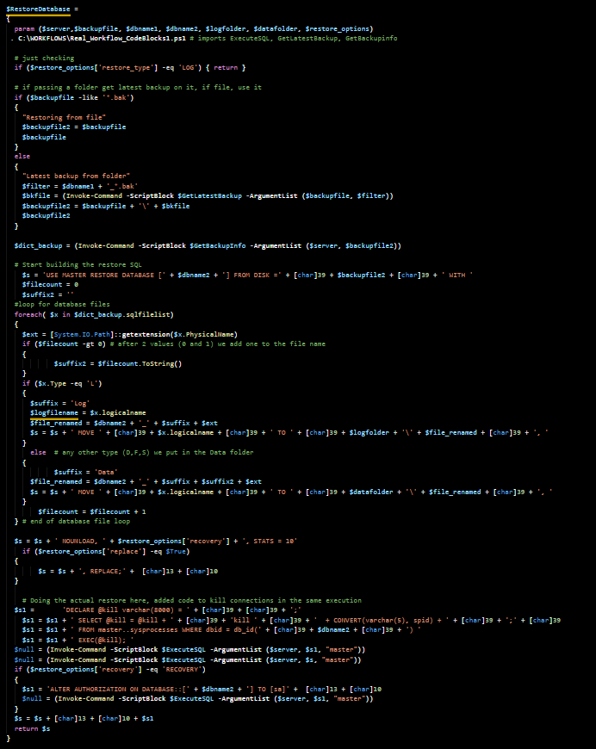
The full code of the $RestoreDatabase script block
Notes:
And this is the full code for the record
And there may be a question from the audience ....

Slide 32
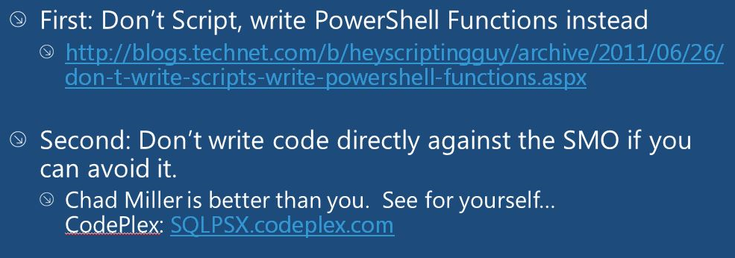
Question from audience: Why taking the trouble of building the convoluted sql to restore the database (and with MOVE for good measure) Use SMO!!!
There is a reason for the madness
Answer: Remember some slides ago, where we mentioned this
Steal from the Best
And Create the Rest
So I applied it, using advise from a presentation by Aaron Nelson
Notes:
I have used SMO based functions in the past, but it is a pain to locate the right setting/parameter/value for them and in the end ... the code was the same size as the one building the SQL ... and I really did not know how it worked

Slide 33
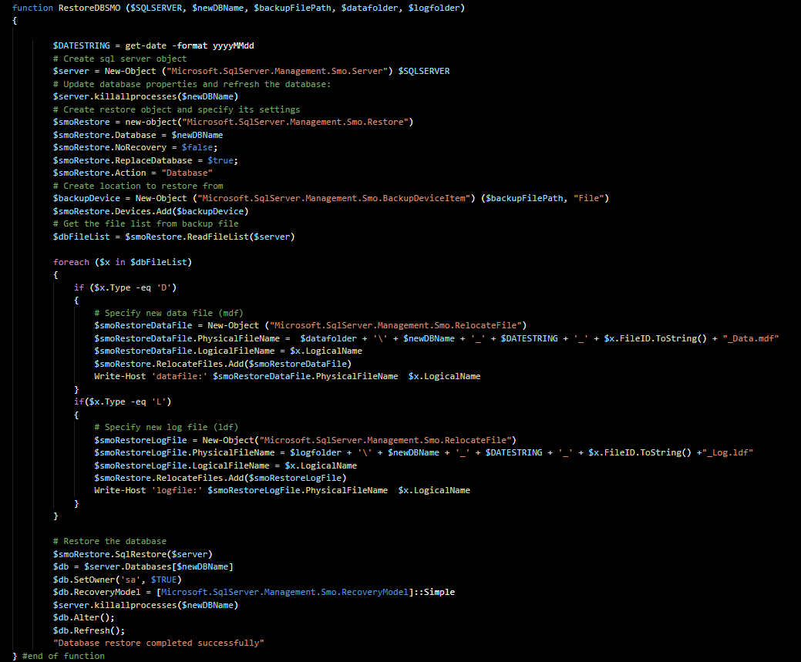
Sample SMO restore function
Notes:
I told you ... and this one does not include the goodies of locating the latest backup

Slide 34
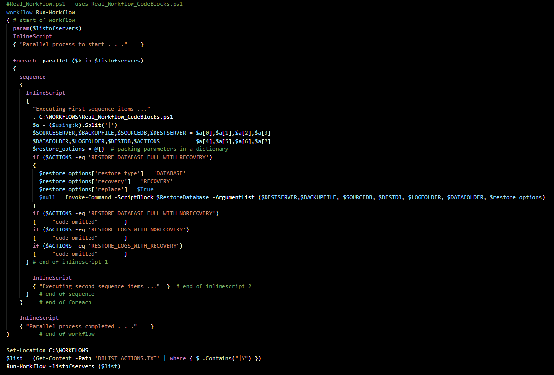
And this is the final product, the workflowized version of the jobs program, nicely packed using imported script blocks
Notes:
We are recycling the same script blocks from the jobs program

Slide 35
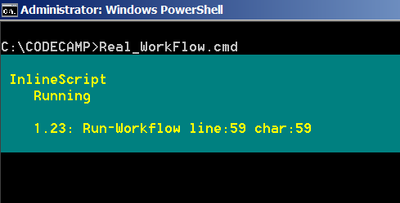
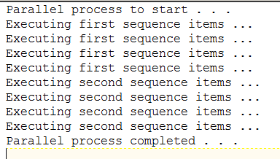
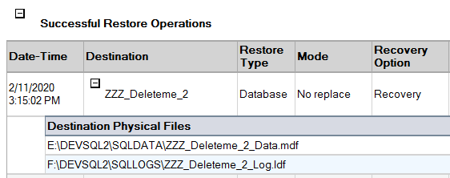
Our “production” workflow works
The usual process, we run it from a cmd file containing this line:
powershell C:\WORKFLOWS\Real_WorkFlow.ps1 > C:\WORKFLOWS\Real_WorkFlow.out
Checking with Management Studio
Notes:
the saved output may have different order in the lines, due to the paralell execution lines may show in different order

Slide 36
Workflows next feature – restarting workflows
One of the uses of workflows is to be able to restart them as needed
In the beginning of this presentation it was mentioned (remember the book definition slide, many slides ago?)
Workflows can be used for
Here we will see the stop and restart feature
And to see it in action let’s bring back our nice Basic_Workflow program, a good candidate for this, because it does a lot of things with not so much code: connects to databases, saves data in files, compresses data and emails report
* Interruptible activities that can be stopped and re-started, which includes surviving a reboot of the system against which the workflow is executing.
Notes:
Let’s see the version with the stop and restart worflow added

Slide 37
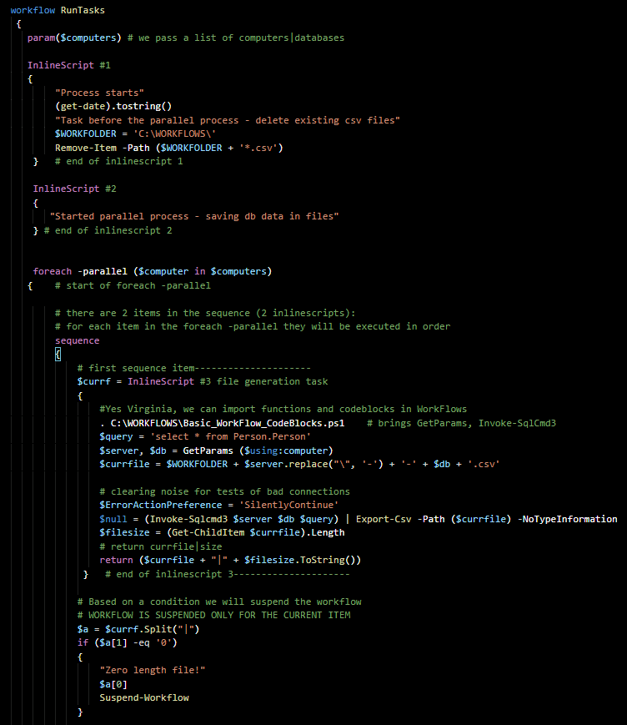
Workflow suspended – screen 1
Notes:
This is the same program showed before, but here we are suspending the workflow based on a condition, in this case we could not create a data file from a database: if file is zero bytes, we stop the workflow

Slide 38
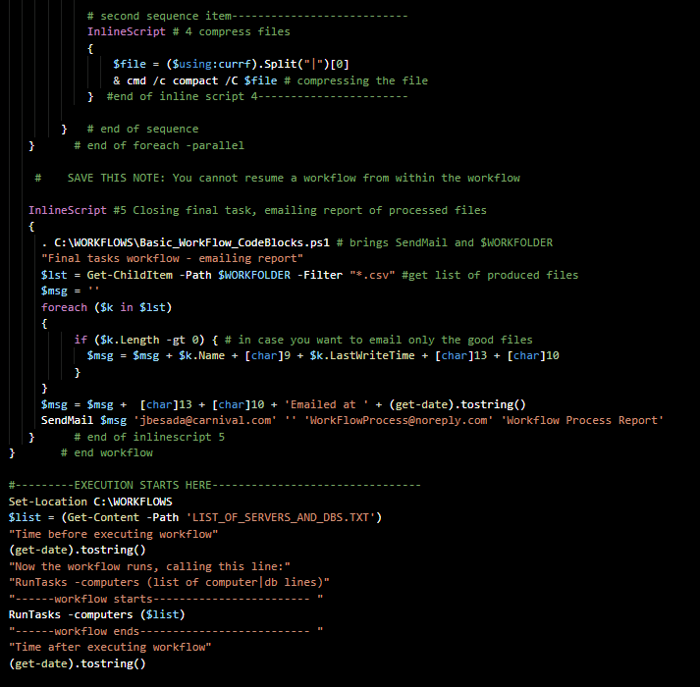
Workflow suspended – screen 2
Notes:
so the second sequence section, where the files are compressed, should not execute, and all later code , like the email sending, should not execute either

Slide 39
All four processes run at the same time
We should get the four files created
With the same timestamp
All should be compressed
And the email will be sent
All processes are launched in parallel
server/db1
server/db2
server/db3
server/db4
file1
file2
file3
file4
email report sent
Notes:
Let’s see a first run without error causing the stop of the workflow

Slide 40
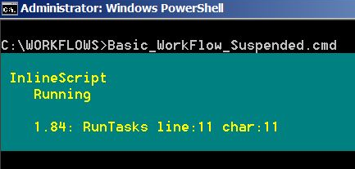
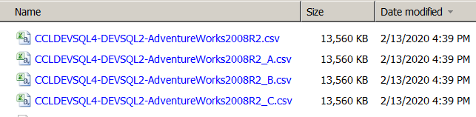
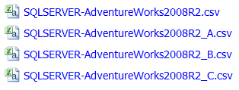
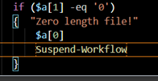


All is well everything worked, no workflow suspension happened
Source file
SQLSERVER|AdventureWorks2008R2
SQLSERVER|AdventureWorks2008R2_A
SQLSERVER|AdventureWorks2008R2_B
SQLSERVER|AdventureWorks2008R2_C
Connection ok for all entries, all files created, condition for suspend workflow not met
Here is the email
Output produced (edited for space, showing 3 files only)
Time before executing workflow
2/13/2020 4:39:20 PM
Now the workflow runs, calling this line:
RunTasks -computers (list of computer|db lines)
------workflow starts------------------------
Process starts
2/13/2020 4:39:26 PM
Task before the parallel process - delete existing csv files
Started parallel process - saving db data in files
Compressing files in C:\WORKFLOWS\
SQLSERVER-AdventureWorks2008R2_C.csv 13884824 : 5206016 = 2.7 to 1 [OK]
Compressing files in C:\WORKFLOWS\
SQLSERVER-AdventureWorks2008R2_A.csv 13884824 : 5206016 = 2.7 to 1 [OK]
Compressing files in C:\WORKFLOWS\
SQLSERVER-AdventureWorks2008R2.csv 13884824 : 5206016 = 2.7 to 1 [OK]
Final tasks workflow - emailing report
------workflow ends--------------------------
Time after executing workflow
2/13/2020 4:39:36 PM
Notes:
In this case all connections to the server/database were succesful, files could be created, none of them were zero bytes

Slide 41

Now we create a condition for stopping the workflow: changing one of the server names to an invalid value
Hey this works:
the process completed
3 compressed files produced
and there was no email sent
------workflow starts------------------------
Process starts
2/14/2020 11:08:13 AM
Task before the parallel process - delete existing csv files
Started parallel process - saving db data in files
Compressing files in C:\WORKFLOWS\
SQLSERVER-AdventureWorks2008R2_C.csv 13884824 : 5206016 = 2.7 to 1 [OK]
1 files within 1 directories were compressed.
13,884,824 total bytes of data are stored in 5,206,016 bytes.
The compression ratio is 2.7 to 1.
Compressing files in C:\WORKFLOWS\
SQLSERVER-AdventureWorks2008R2_B.csv 13884824 : 5206016 = 2.7 to 1 [OK]
1 files within 1 directories were compressed.
13,884,824 total bytes of data are stored in 5,206,016 bytes.
The compression ratio is 2.7 to 1.
Compressing files in C:\WORKFLOWS\
SQLSERVER-AdventureWorks2008R2.csv 13884824 : 5206016 = 2.7 to 1 [OK]
1 files within 1 directories were compressed.
13,884,824 total bytes of data are stored in 5,206,016 bytes.
The compression ratio is 2.7 to 1.
Zero length file!
C:\WORKFLOWS\SQLSERVER-AdventureWorks2008R2_AX.csv
Id Name PSJobTypeName State HasMoreData Location
-- ---- ------------- ----- ----------- --------
1 Job1 PSWorkflowJob Suspended True localhost
------workflow ends--------------------------
Notes:
Ok this is fine and dandy, the program completed, lets see what happens when we resume the workflow

Slide 42

Now we are in a kind of limbo status Our program completed We know that there sould be something going on somewhere
It is time to get back to our enlightment training
We spoke about jobs, it was said that workflows are the ultimate modern thing ...
But to resume the workflow ...
You need the jobs paraphernalia ... which was mentioned en passant like a minor thing before many slides ago
So we check in a powershell session what jobs are running. Let’s open a PowerShell command window and execute
Get-Job ...
and ...
... we realize that working on workflows we were creating jobs!
note to aspiring politicians in the audience, you can use this for you campaigns
Notes:
with this out of the way we are ready to continue, let resume the workflow

Slide 43
Resuming workflows for the rest of us
There are two ways to resume the workflow
The first one is to dig in the documentation of both jobs and workflows, learn the many switches there, use them as appropiate. Been there, done that, total confusion
The second one is this:
Use this line of code within another powershell script, let’s name it ResumeWorkflow.ps1
# SAVE THIS LINE
Get-Job -State Suspended | Resume-Job -Wait| Wait-Job
Wrap it in a cmd file like this one, conveniently named ResumeWorkflow.cmd
powershell C:\WORKFLOWS\ResumeWorkFlow.ps1 > C:\WORKFLOWS\ResumeWorkFlow.out
And execute it
Notes:
Let see what happens upon execution, remember during all this talk and slide showing the job has been there ... waiting

Slide 44



And our stopped worklow could be resumed
Before
After
Output, State changes to Completed
Generated output file:
Id Name PSJobTypeName State HasMoreData Location
-- ---- ------------- ----- ----------- --------
2 Job1 PSWorkflowJob Completed True localhost
Time after resuming workflow
2/14/2020 2:59:20 PM
And we get our email!
server name ommited
Notes:
So let’s resume all of this

Slide 45
Stopping and Resuming Workflows ... Resumed
In your worflow script place the call to
Suspend-Workflow
In the right place (*) for the condition needed
2) Have your ResumeWorflow.cmd file ready
3) Execute your workflow
4) Execute if needed you ResumeWorkflow.cmd
Note here: no issue if you execute your ResumeWorkflow twice or more times: no harm done, see the output (no jobs shown)
Time after resuming workflow
2/14/2020 3:17:12 PM
(*) you will very soon discover that you cannot place the condition inside your trusty InlineScripts, it has to be out in the Orange zone (check one of the first slides)
Notes:
And this concludes our Worflows presentation, but don’t go anywhere ...

Slide 46


Slide 47
links
All source code here
https://drive.google.com/open?id=1aNNzwni5BBe-iONJgxrBka8e4QZEoTDN
link to Snover’s talk about programming with hand grenades (near the 5:30 minutes)
https://channel9.msdn.com/Shows/Going+Deep/Expert-to-Expert-Erik-Meijer-and-Jeffrey-Snover-Inside-PowerShell?term=E2EMeijerSnoverPowerShell_ch9.wmv&lang-en=true
Keep this link handy, you will need it
https://devblogs.microsoft.com/scripting/powershell-workflows-the-basics/

